Slide 1
WORKSHOP AI

Slide 2

Agenda
Presentación Workshop
Ponentes
Asistentes
Requisitos Previos
Canal de comunicación: Slack
Material Workshop: Github
Agendas
Día 1. Cognitive Services
Dia 2. ML Azure & Deployment
Dia 3. Databricks & NLP

Slide 3



Presentación Workshop
Alexander González
AI Software Engineer
Rodrigo Cabello
AI Team Lead
Eric Martín
AI Chapter Lead

Slide 4




Requisitos Previos
Anaconda. Gestor de paquetes y entornos virtuales
https://www.anaconda.com/distribution/#download-section
Editor de código.
VScode: https://code.visualstudio.com/download
Subscripción de Azure

Slide 5


Canal de comunicación
plain-concepts-group.slack.com
Canal: workshop-ai-madridplai
Material Workshop
https://github.com/mrcabellom/AIWorkshopMadrid

Slide 6
Agenda Día 1
Introducción AI/ML/DL
Principales Aplicaciones AI
Microsoft & AI.
Servicios Cognitivos
Introducción
Catálogo
Vision (Face, Computer Vision, Video Indexer, Content Moderator..)
Text (Translate, text analytics, spell check...)
Knowledge mining (Azure Search)
Custom Vision
Custom Vision SDK
LABS
Break 20 min
Comida 1 hora

Slide 7
Agenda Día 2
Caso práctico
Introducción Machine/Deep Learning workflow
Data
Data source
Data cleansing
Data pre-processing
Selección de características
Selección de modelos
Training/Validation/Test
Métricas y evaluación
MLOPS: Despliegue/Produccionalización
Workflow con Azure Machine Learning y MLflow
Break 20 min
Comida 1 hora

Slide 8
Agenda Día 3
Databricks:
Procesamiento de datos.
Introducción NLP:
DEMO word2vec y fasttext básico
Hiperparámetros
Preprocessing
Tokenize
Punkt
StopWords
Lemmatization
Stemming
Librerias
DEMO preprocessing + ajuste de hiperparametros
Principales problemas NLP
Taller end2end RNN classificador con tensorflow
Break 20 min
Comida 1 hora

Slide 9
WORKSHOP DÍA 1

Slide 10
Agenda
Introduction: AI, ML, DL
Microsoft & AI
Cognitive Services
Introduction Cognitive Services
Catalogue API's
Vision (Face, Computer Vision, Video Indexer, Content Moderator..)
Text (Translate, text analytics, spell check...)
Knowledge mining (Azure Search)
Lab1
Custom Vision
Explainability Custom Vision SDK
Lab2

Slide 11
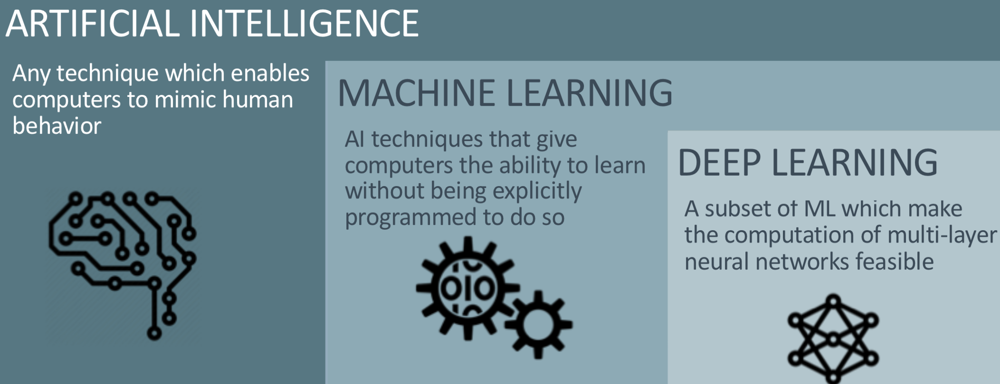
Introduction – AI, ML & DL

Slide 12
ML Areas
Image
Sound
Fraud Detection
Object Detection
Style Impersonation
Texto
Knowledge Mining
Sentiment Analysis
Style Transfer
Signal
Temporal Series
Defect correction
Image Classification
Synthetic Image Generation
Predictive Maintenance

Slide 13
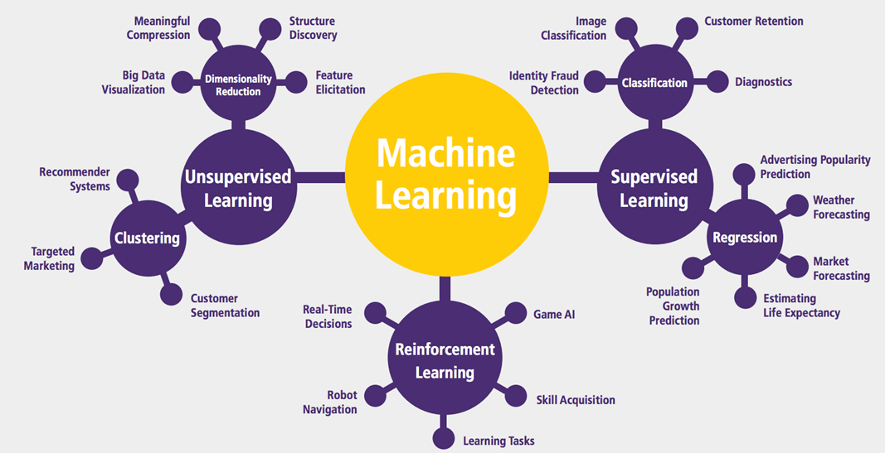

Slide 14
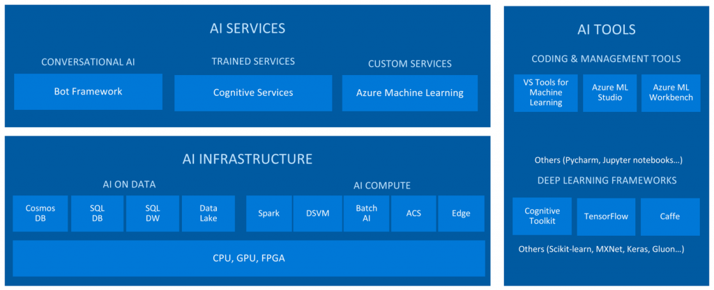
Microsoft and AI

Slide 15
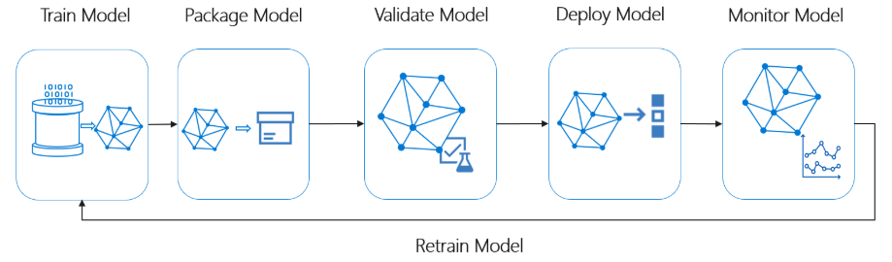
Azure Machine Learning/MLOPS

Slide 16
Cognitive Services

Slide 17



Cognitive Services are a set of machine learning algorithms that Microsoft has developed to solve problems in the field of Artificial Intelligence (AI).
When to use Cognitive Services? Whenever the project can be solved using one of these solutions. Very good results in exchange of very little development
Roll your own with REST API’s. Simple to add just a few lines
Make the same API code call on IOS, Android. Integrate into de language and platform of your choice
Build by experts in their field from Microsoft Researcher, Bing, and Azure Machine Learning. Quality documentation, sample code and comunnity support

Slide 18

Cognitive Services
Vision
From faces to feelings, allow your apps to understand images and video
Speech
Hear and speak to your users by filtering noise, identifying speakers, and understanding intent
Microsoft Cognitive Services
Give your apps a human side
Language
Process text and learn how to recognize what users want
Knowledge
Tap into rich knowledge amassed from the web, academia, or your own data
Search
Access billions of web pages, images, videos, and news with the power of Bing APIs

Slide 19
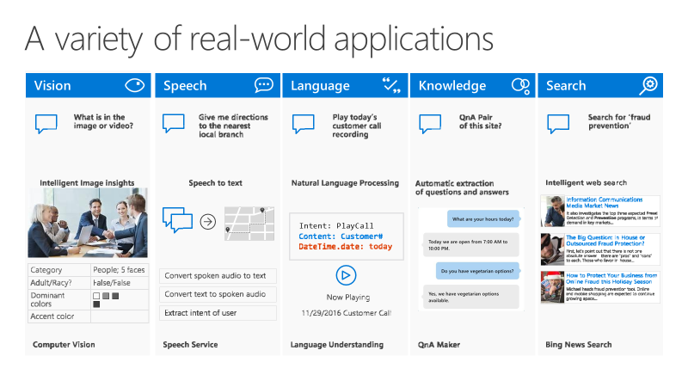

Slide 20






LAB
Documents
Intelligence
Vision
Text
Knowledge

Slide 21
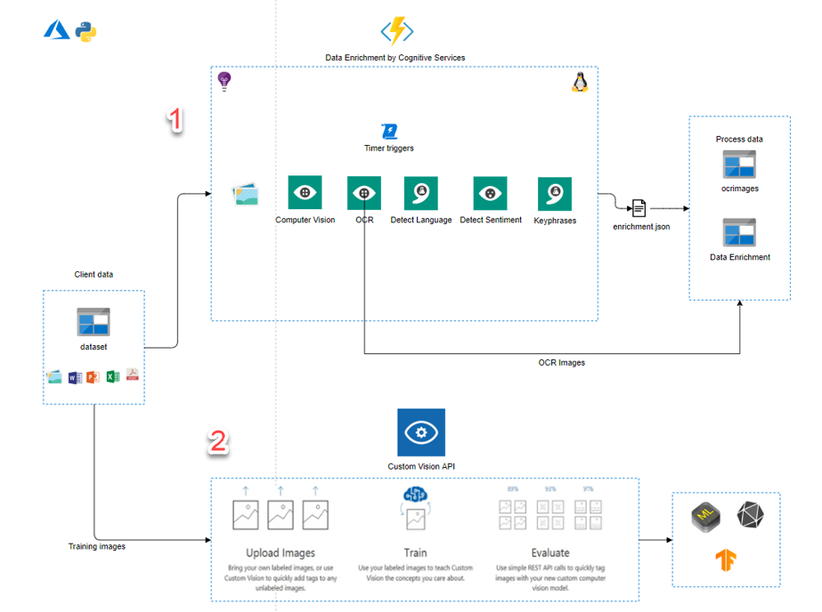

Slide 22






Slide 23






Slide 24

Cognitive Services Labs
Developer Resources
LAB 01
https://github.com/

Slide 25

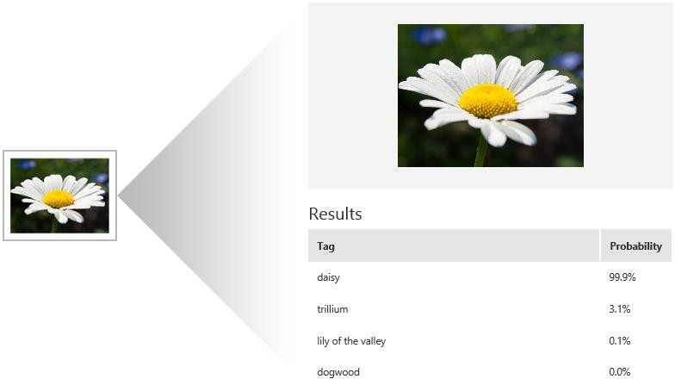




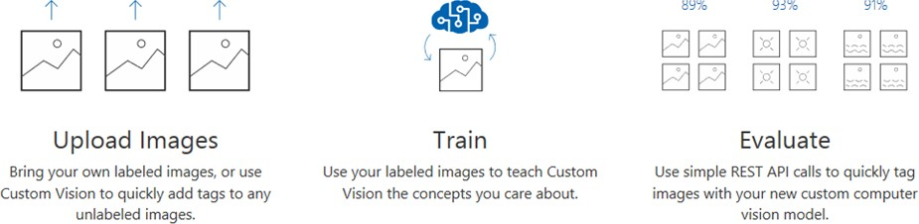


Slide 26
Cognitive Services Labs
Developer Resources
LAB 02
https://github.com/

